Slide 1
Non-deterministic Finite Automaton (NFA)
CSC3113: Theory of Computation
5
3
Summer 2020-2021
Dr. Hossain Md Shakhawat, Assistant Professor,
Department of Computer Science, Faculty of Science & Technology.
shakhawat@aiub.edu

Slide 2
Nondeterministic Finite Automata (NFA).
Running NFA, NFA Tree.
Formal Definition of NFA.
Practice, solve exercise of NFA.

Slide 3
Understand, learn & practice with example
Formal Definition of Nondeterministic Finite Automata (NFA)
Practice designing NFA.

Slide 4
All outcome are represented with examples
Understand, learn & formal definition of NFA.
Practice & Design of NFA

Slide 5
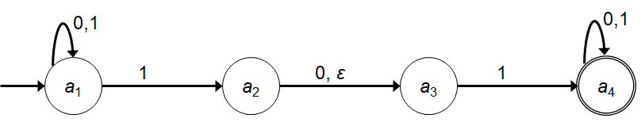
Nondeterministic Finite Automata (NFA)
State Diagram and the Properties of NFA
We already know DFA, so it would be sufficient to look into the differences of properties between the two.
In NFA a state may have –
Zero or more exiting arrows for each alphabet symbol.
Zero or more exiting arrows with the label ε.
So we can see that, not all steps of a computation follows in a unique way from the preceding step. There can be multiple choices to move from one state to another with a symbol. That’s the reason it’s computation is called nondeterministic.

Slide 6
Running an NFA
If we encounter a state with multiple ways to proceed –
The machine splits into multiple copies of itself and follows all the possibilities in parallel.
Each copy of the machine takes one of the possible ways to proceed and continues as before.
If there are subsequent choices, the machine splits again.
If a state with an ε symbol on an exiting arrow is encountered without reading any input, the machine splits into multiple copies,
one following each of the exiting ε-labeled arrows and
one staying in the current state.
If the next input symbol doesn’t appear on any of the arrows exiting the state occupied by a copy of the machine, that copy of the machine dies, along with the branch of the computation associated with it.
If any one of these copies of the machine is in an accept state at the end of the input, the NFA accepts the input strings.
So, nondeterminism may be viewed as a kind of parallel computation wherein several processes can be running concurrently.
If at least one of these processes accepts then the entire computation accepts.

Slide 7
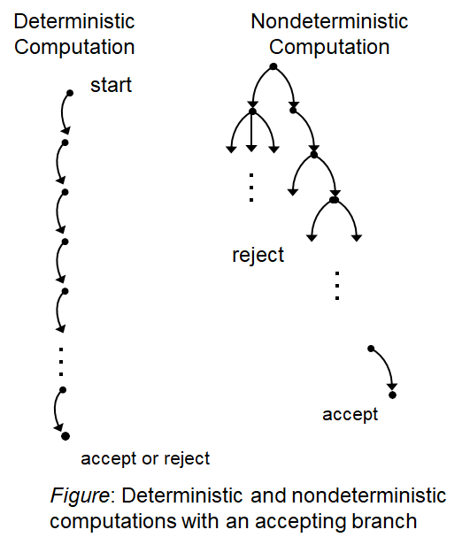
Running an NFA
Another way of viewing a nondeterministic computation is as a tree of possibilities.
The root corresponds to the start of the computation.
Every branching point in the tree corresponds to a point in the computation at which the machine has multiple choices.
The machine accepts if at least one of the computation branches ends in an accept state.
Tree representation

Slide 8
NON-Deterministic Finite Automata (NFA)
A Finite Automata(FA) is said NFA, if there is more than one possible transition from one state on the same input symbol. Here every next step may have zero or more number of choices to move on.
A NFA is a 5 tuples {Q, Σ, q_{o}, F, δ} where,
Q : is a finite set (nonempty) of all states
Σ : is finite set (nonempty) of input symbols called alphabet. (Symbols which machine takes as input )
q_{o} : is the starting or initial state, q_{o} ∈ Q
F : is the nonempty set of final (accept) states, F ⊆ Q
δ : is the transition function, defined as Q × Σ → 2^{Q} (takes a state from Q and an input from Σ then returns a subset of Q
we can also write as δ : Q × Σ_{ε} → P(Q)
(takes a state from Q and an input symbol or the empty string (Σ_{ε}=Σ ∪ ε) then returns the set of possible next states (P(Q) is the power set of Q).

Slide 9

How do we know that a NFA will accept a language ?
If we run a language in a machine/NFA and the machine ends in a set of states out of which at least one state is a final state. Then we can say that the NFA will accept the language.
L={w: w is string that ends with 0}
0, 1
A
0
B
Let’s draw the flow of states for string 100. Will it be accepted ?
A
A
0
A
1
A
0
B
B
{A,B} is the set of states through which machine ends
Here, B is a final state. Therefore, 100 will be accepted in that NFA

Slide 10
Simulation – NFA Tree
1
0,1
0,
010110
a₁
1
a₂
0,
ε
a₃
1
a₄
Symbol read
0 ----------------------------------------------------------------------------------
1 -----------------------------------------------------------------------
0 ----------------------------------------------------------------
1 ----------------------------------------------------------
1 ------------------------------------------------
0 ------------------------------------------
a₁
a₁
a₁
a₂
a₃
a₁
a₃
a₁
a₂
a₃
a₄
a₁
a₂
a₃
a₄
a₄
a₁
a₃
a₄
a₄
a₄
a₄

Slide 11
Nondeterministic Finite Automata (NFA)
Formal Definition
Let, the above NFA N₁ = (Q₁, Σ, δ₁, a₁, F₁).
Q₁ = {a₁, a₂, a₃, a₄}.
Σ = {0, 1}.
δ₁ | 0 1 ε
a₁ | {a₁} {a₁, a₂} φ
a₂ | {a₃} φ {a₃}
a₃ | φ {a₄} φ
a₄ | {a₄} {a₄} φ
a₁ is the start state.
F₁ = {a₄}.
δ₁ in form δ : Q × Σ_{ε} → P(Q)
δ₁(a₁, 0) = {a₁} δ₁(a₁, 1) = {a₁, a₂} δ₁(a₁, ε) = φ
δ₁(a₂, 0) = {a₃} δ₁(a₂, 1) = φ δ₁(a₂, ε) = {a₃}
δ₁(a₃, 0) = φ δ₁(a₃, 1) = {a₄} δ₁(a₃, ε) = φ
δ₁(a₄, 0) = {a₄} δ₁(a₄, 1) = {a₄} δ₁(a₄, ε) = φ
Q × Σ_{ε} = {(a₁, 0), (a₁, 1), (a₁, ε), (a₂, 0), (a₂, 1), (a₂, ε), (a₃, 0), (a₃, 1), (a₃, ε), (a₄, 0), (a₄, 1), (a₄, ε)}
P(Q) = {φ, {a₁}, {a₂}, {a₃}, {a₄}, {a₁,a₂}, {a₁,a₃}, {a₁,a₄}, {a₂,a₃}, {a₂,a₄}, {a₃,a₄}, {a₁,a₂,a₃}, {a₁,a₂,a₄}, {a₁,a₃,a₄}, {a₂,a₃,a₄}, {a₁,a₂,a₃, a₄}}

Slide 12
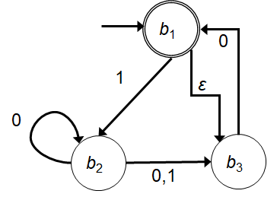
Nondeterministic Finite Automata (NFA)
Example
Let, the above NFA N₂ = (Q₂, Σ, δ₂, b₁, F₂).
Q₂ = {b₁, b₂, b₃}.
Σ = {0, 1}.
δ₂ is given as – | 0 1 ε b₁ | φ {b₂} {b₃} b₂ | {b₂, b₃} {b₃} φ b₃ | {b₁} φ φ
b₁ is the start state.
F₂ = {b₁}.

Slide 13
Practice NFA

Slide 14
B1 ={w : w is a binary string containing an odd number of 1s}.
B2 ={w : w is a binary string containing an even number of 0s}.
∑ = {0,1}
1
0
0
q1
q2
B1
1
0
1
1
1
q1
0
q2
q3
B2
0
OR
0
1
1
q1
q2
B2
0

Slide 15
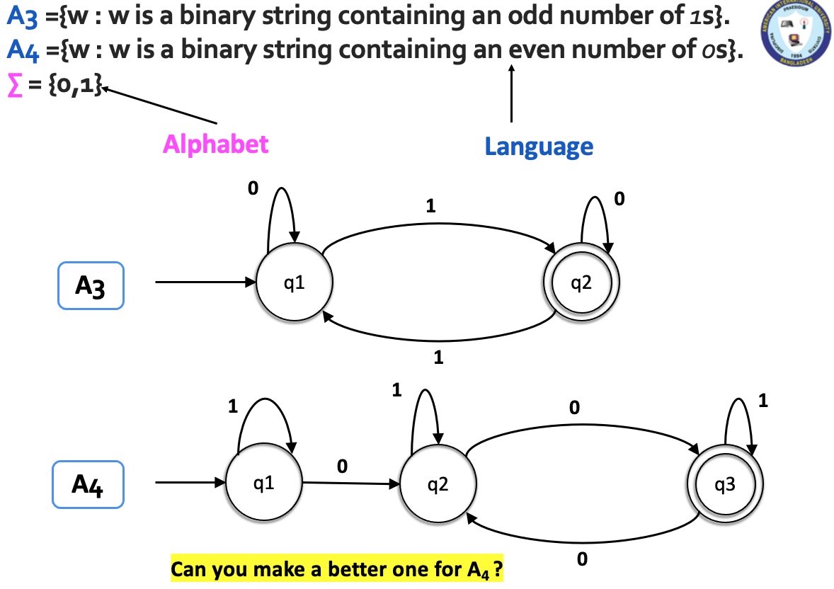
How was DFA?
NFA and DFA design is same for these languages

Slide 16
B3 ={w| w ends with a 0}.
B4 ={w| w begins with a 1}.
B5 ={w| w begins with a 1 and ends with a 0}.
∑ = {0,1}
0, 1
q1
0
q2
B3
In NFA no need to transit/lead to a dead state
q1
1
q2
0, 1
B4
0, 1
q1
1
q2
0
q3
B5

Slide 17
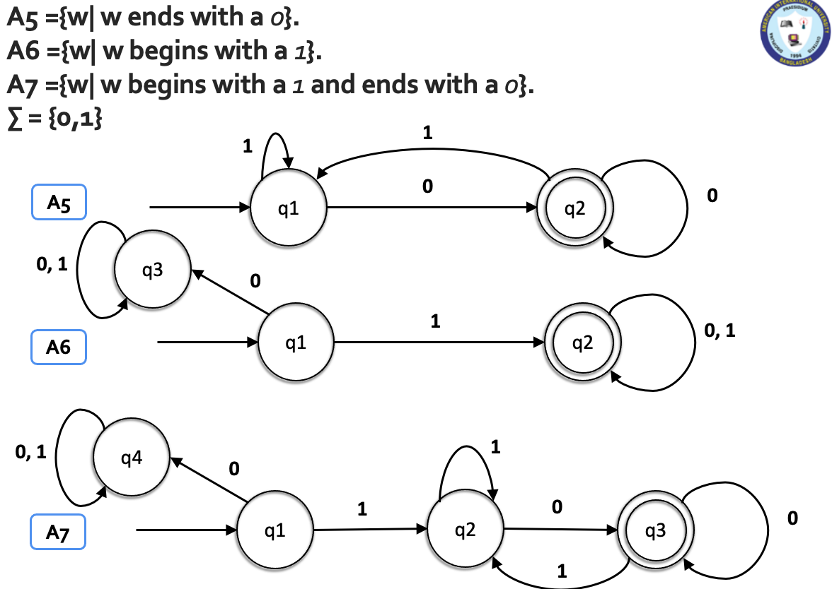
How was DFA?

Slide 18
B₆ ={w| w has at least two 1s}.
B7 ={w| w has at most two 1s}.
∑ = {0,1}
0
0
0, 1
1
1
B₆
q1
q2
q3
0
0
0
1
1
B7
q1
q2
q3
In NFA no need to transit/lead to a dead state

Slide 19
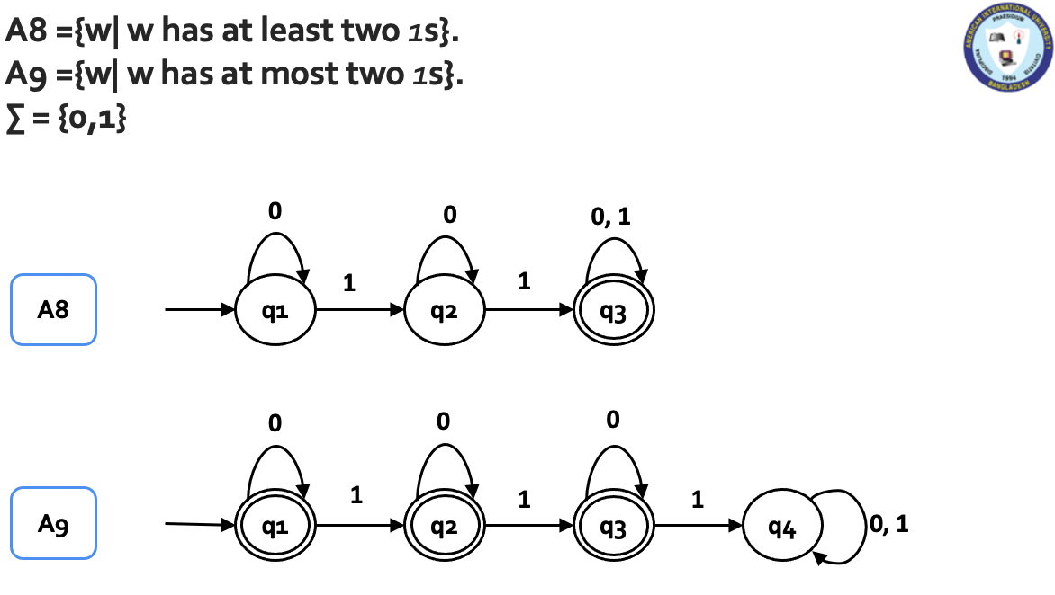
How was DFA?

Slide 20
B₈ ={w| w has substring 101}.
B9 ={w| w has substring 011}.
∑ = {0,1}
0,1
B₈
1
0
q10
1
q101
qs
q1
0, 1
0, 1
0
1
0
1
q01
1
q011
B9
qs
q0
0, 1
0
What happens for the language, A2 ={w| w does not have substring 011}?

Slide 21
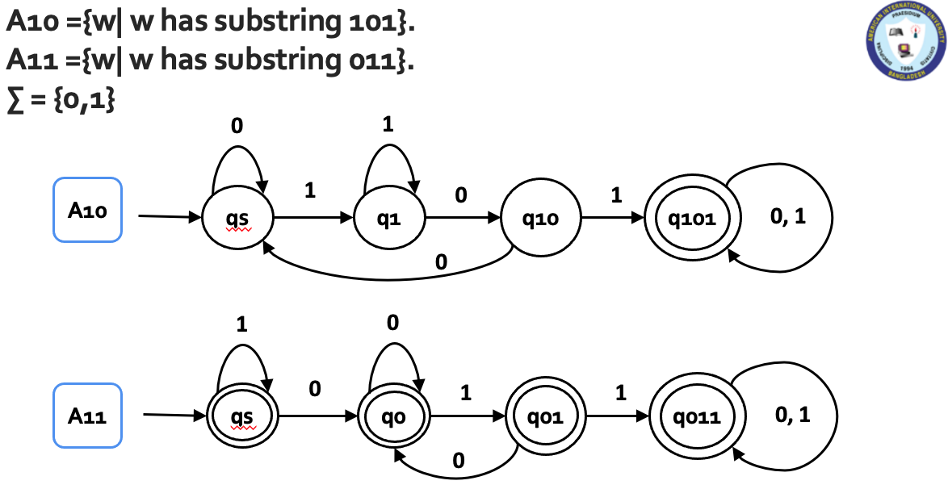
How was DFA?

Slide 22
B10 ={w| w starts with a 1 and has even length or w starts with a 0 and has odd length}.
∑ = {0,1}
0, 1
q2
0, 1
q3
1
B10
q1
0, 1
0
q4
0, 1
q5

Slide 23
Nondeterministic Finite Automata
Introduction to Theory of Computation, Sipser, (3rd ed), NFA.

